Slide 1
Leaving no one behind: making the law accessible for all across the Pacific region
Kym Freriks, Managing Editor, PacLII
with Liliviwa Baleimatuku, Deputy Managing Editor, PacLII
Law via the Internet Conference 2024
Limassol, Cyprus

Slide 2
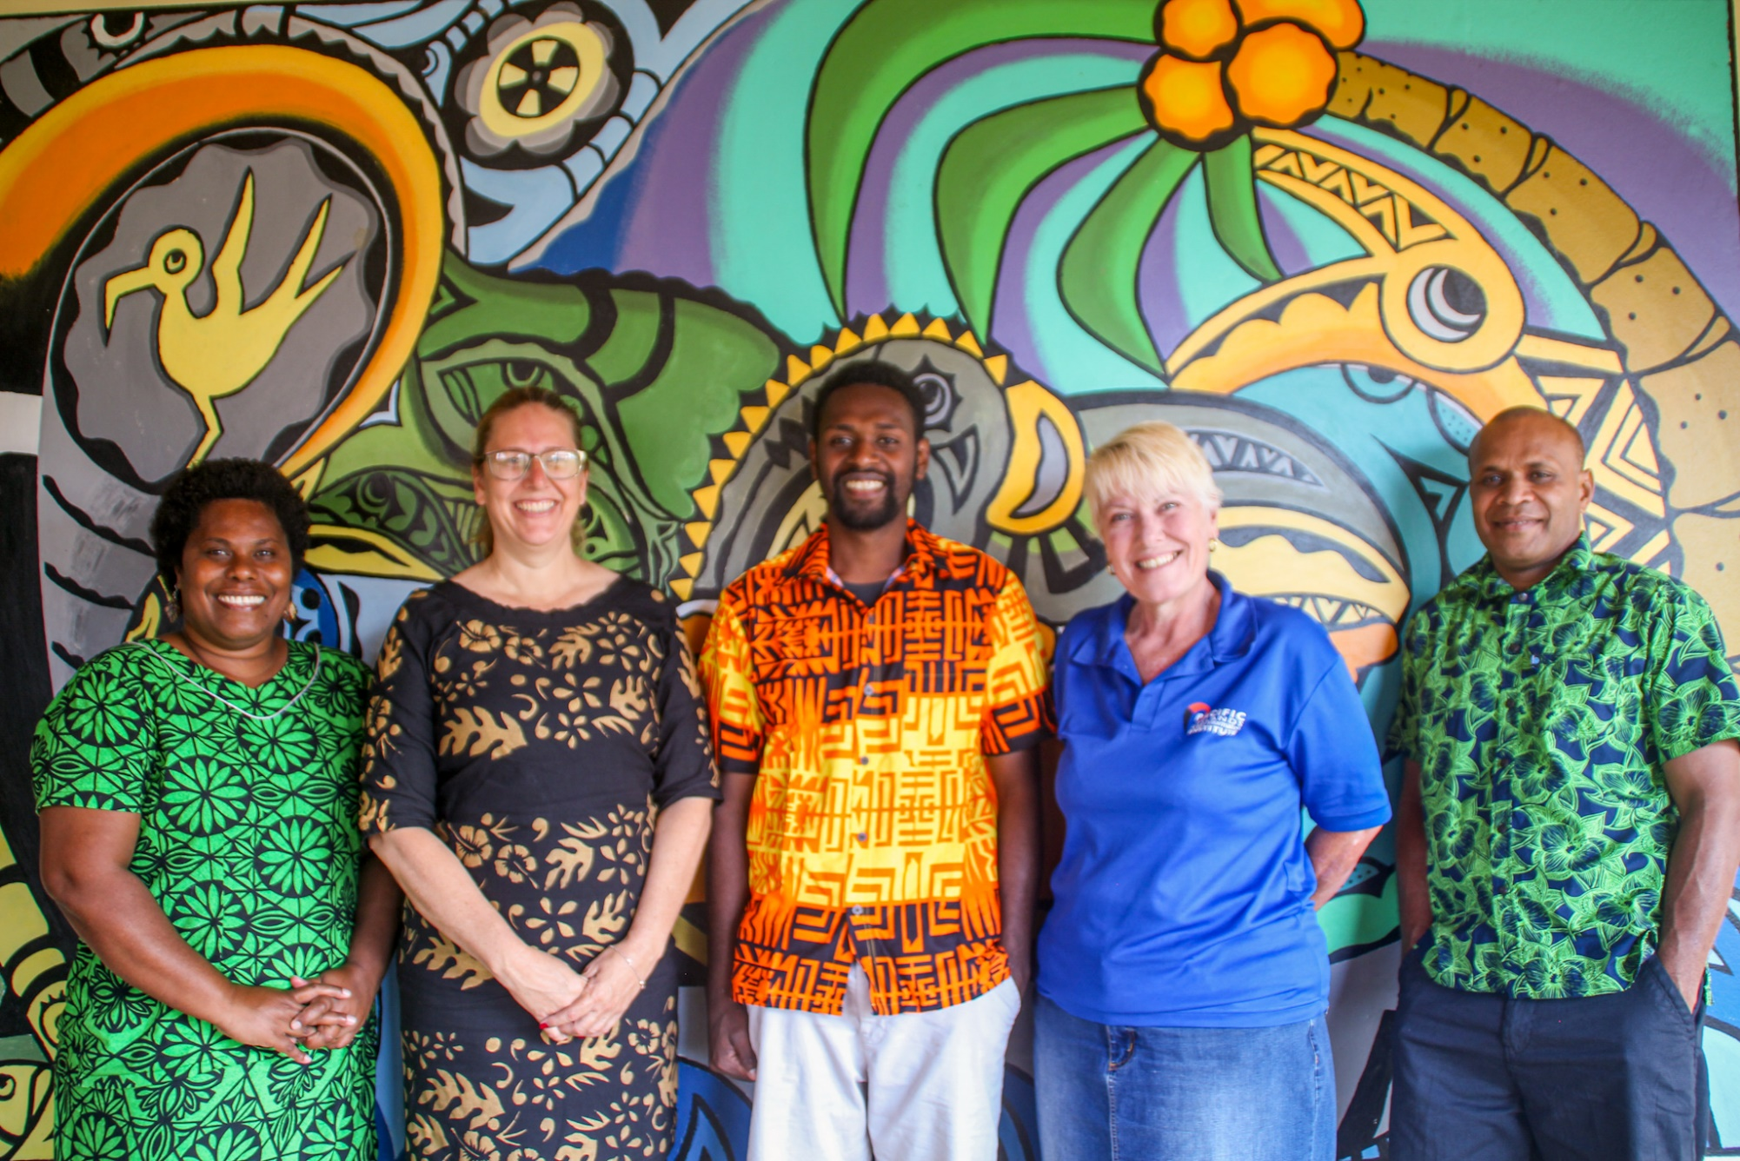
PacLII Team

Slide 3
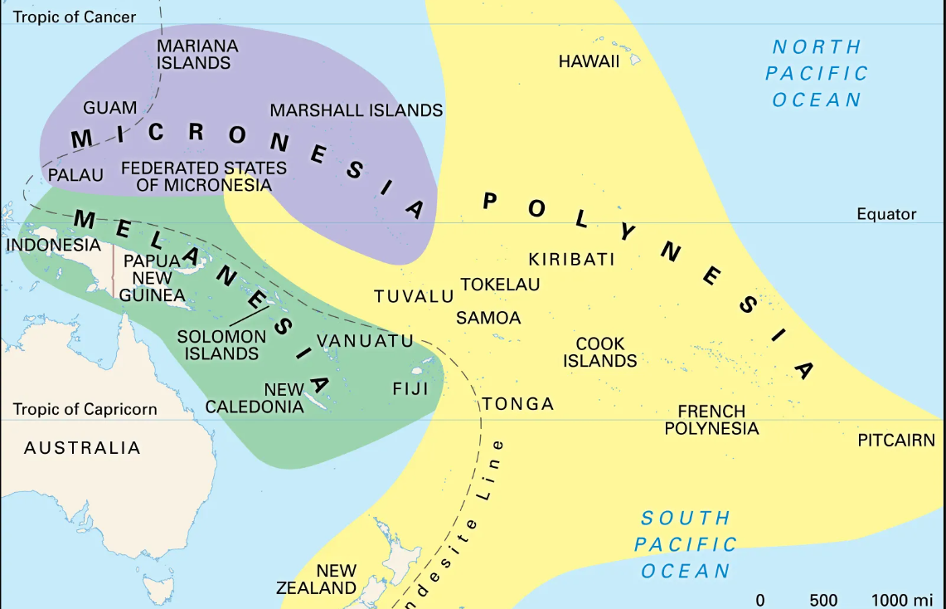
Cultural Regions of the Pacific
Sources of Law
Constitutions
Written/Unwritten rules of customary law
Laws adopted by former colonial powers
Acts and Regulations enacted by the jurisdiction
Case law
Foster, Sophie and West, Francis James. "Pacific Islands". Encyclopedia Britannica, 9 Sep. 2024, https://www.britannica.com/place/Pacific-Islands. Accessed 15 September 2024.

Slide 4
PacLII Context – Is it still needed?
In 2023, PacLII recorded 23.6 million visits to its website.
Fiji Womens Rights Movement:
“Part of the work that we do under the thematic area of Women’s Access to Justice, is that we analyze court cases to see how judgements are reached and rationale for sentencing, more specifically in rape cases. We have been analyzing rape cases in Fiji since 2016 to date, and have relied on cases published on PacLII to be able to do this very crucial work … having regular updated cases published on PacLII is of utmost benefit to us at FWRM as it makes our work easier in terms of accessing published court cases. It is our hope that PacLII continues to be funded in the future.”

Slide 5
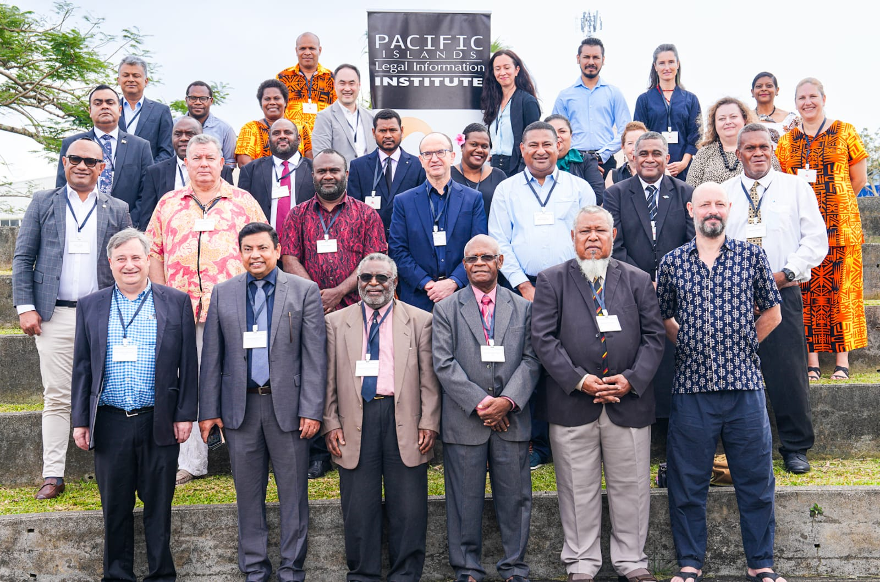
PacLII Context - Is it still needed?
PacLII Stakeholder Summit 2023
Core funding – DFAT/UK
Project Funding – small grants

Slide 6
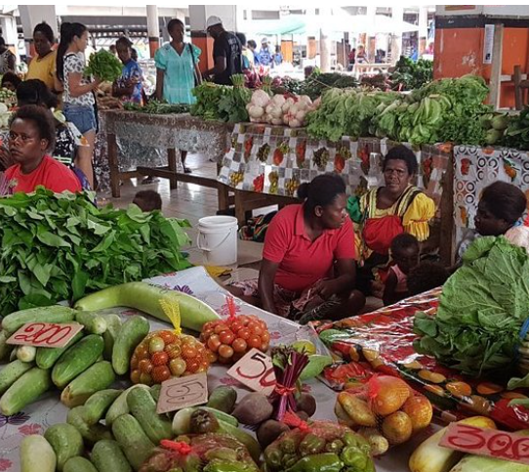
2030 Agenda for Sustainable Development
Leave No one Behind – 17 Goals
SDG 4: Quality education;
SDG 5: Gender equality;
SDG 9: Industry, Innovation and Infrastructure;
SDG 10: Reduced inequalities;
SDG 16 Peace Justice and Strong Institutions

Slide 7
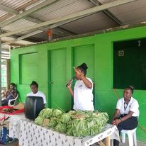
Challenges to Access to Legal Information
Government Policies and Attitudes to the Right to Legal Information
Resource constraints
Remoteness and Technological barriers
Literacy
Photo credit: Cathy Hite

Slide 8
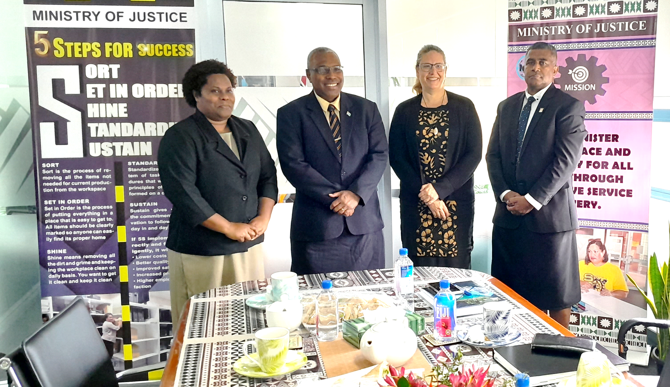
Challenges to Access to Legal Information Government Policies and Attitudes to the Right to Legal Information
“…when our citizens are informed, government can be held accountable for its policies.”
Fiji Government, “Attorney General delivers his maiden speech” (2024).
Photo credit: Cathy Hite

Slide 9
Challenges to Access to Legal Information Resource constraints
VANUATU | Judgments: Judiciary of the Republic of Vanuatu https://courts.gov.vu/court-activity/judgments 2017-2024 | HTML & PDF | Search by Judge, Counsel, dates, keyword in judgment text. Keyword search did not work.
 | Consolidated Legislation: No website
 | Session laws: No website
Photo credit: Cathy Hite

Slide 10
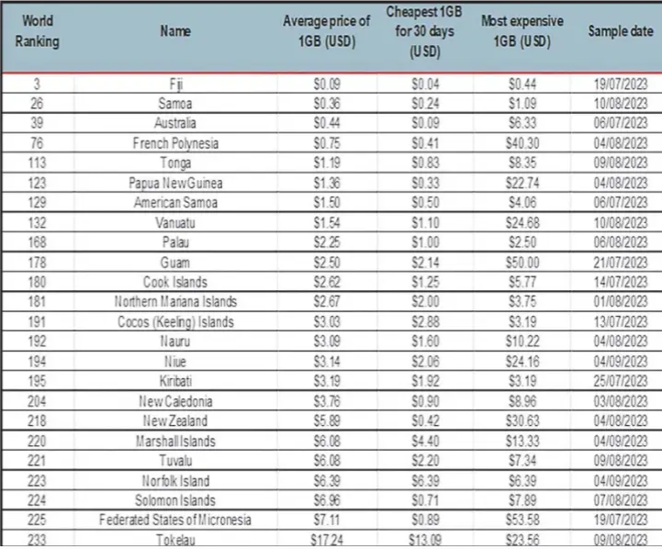
Challenges to Access to Legal Information Remoteness and Technological barriers
Prasad, Ashnil (2023) Cost of going Online: a Pacific case study, https://www.pressreader.com/fiji/the-fiji-times/20231122/281968907427414

Slide 11
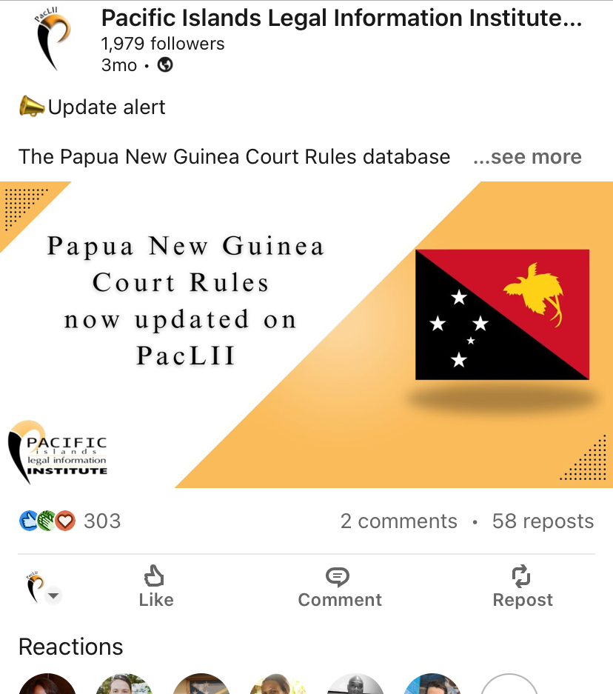
Challenges to Access to Legal Information Remoteness and Technological barriers
Samoa - A survey in 2020 showed that 33% of respondents never use the internet
PNG - “I have a friend who is practicing in a remote province in my country where internet access is not consistent. He has asked me to find a way to copy the Paclii website for offline access. This has been difficult.”

Slide 12
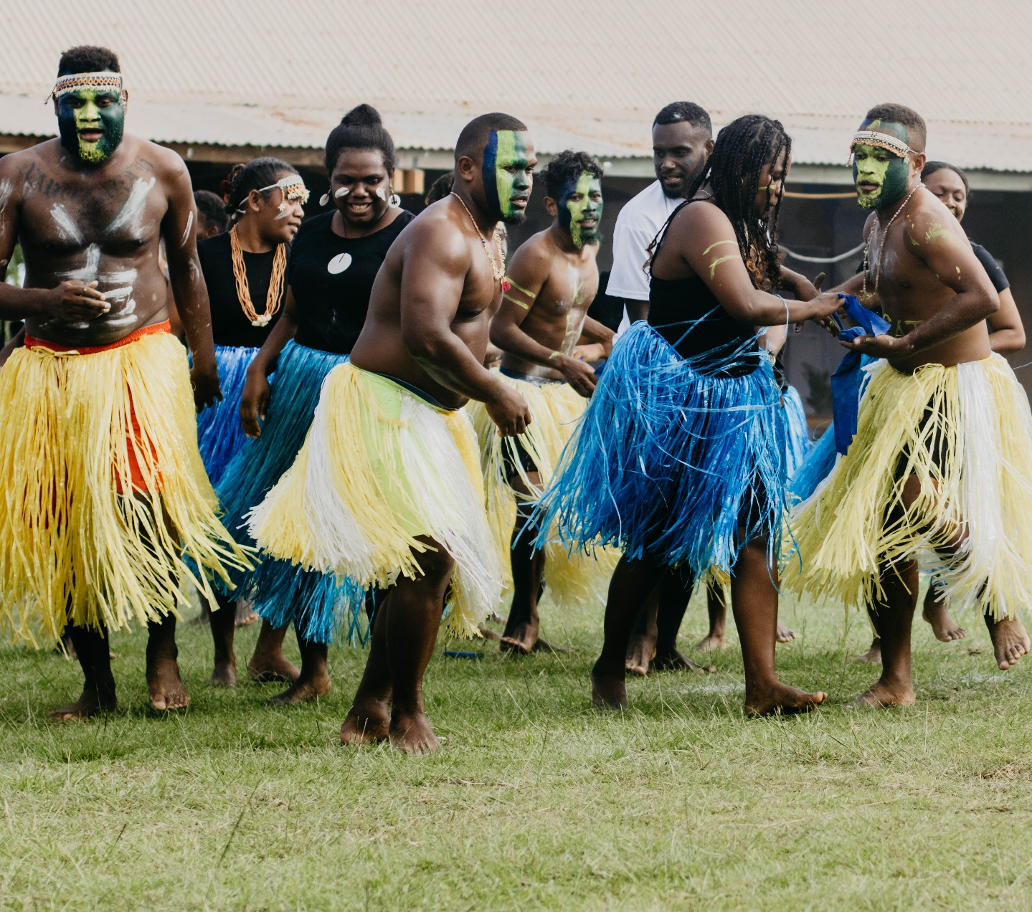
Challenges to Access to Legal Information Literacy
Solomon Islands – pop. 721,455 in 2019, has over 70 local languages.
Vanuatu – pop. 221,506 has 113 indigenous languages (with 3 official languages: English, French and the local pidgin, Bislama).
Papua New Guinea – pop. 17 million in 2022, has 840 living languages

Slide 13
How can PacLII enhance better community access to legal information in the Pacific?
Surveys and engagement
Prioritising data publication for community interests
Staying current with methods to improve community accessibility
Community outreach & Social media
Photo credit: Cathy Hite

